Slide 1
Cradle-to-Career Data System EDGE Coalition Briefing March 2021

Slide 2
The challenge: California needs actionable information
California has separate, disconnected information on various education systems, social service programs, and employment.
It has been challenging to identify barriers and successes for Californians as they move from early childhood through adulthood.
Actionable information needs to be in the hands of communities and families to help create better outcomes for all Californians.

Slide 3
Taking action: The Cradle-to-Career data system
In 2019, California enacted the Cradle-to-Career Data System Act, which called for the establishment of a state longitudinal data system to link existing education, social services, and workforce information.
The Act articulated the scope of an 18-month planning process to be shaped by a workgroup that consists of the partner entities named in the Act. The planning process, which is being overseen by the Governor’s Office and managed by WestEd, runs from January 2020-June 2021.

Slide 4
A collaborative approach to designing a solution
Partner entities include:
Early Learning and K-12: California Department of Education, State Board of Education
Postsecondary: the Association of Independent California Colleges and Universities, Bureau for Private Postsecondary Education, California Community Colleges, California State University, University of California
Education-Related Entities: California Student Aid Commission, Commission on Teacher Credentialing
Employment and Workforce Training: Employment Development Department, Labor and Workforce Development Agency
Social Services and Health: California Department of Social Services, California Health and Human Services Agency
Data Experts: California Department of Technology, California School Information Services
Members of the public are also helping to develop proposals and reviewed recommendations through two advisory groups (Policy & Analytics Advisory Group and Practice & Operations Advisory Group) and five subcommittees (Definitions, Technology & Security, Common Identifier, Research Agenda, and Community Engagement Subcommittees).
There are more than 200 people involved in the planning process.

Slide 5
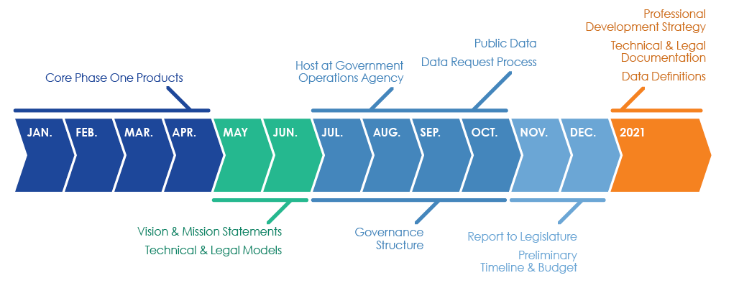
Planning Timeline

Slide 6
Timeline for implementation
Initial legislative report was submitted at the end of December 2020
The Governor’s budget included funding for the 2021-22 fiscal year and the workgroup recommendations for the data system have been included in both the trailer bill and legislation introduced by Irwin
Other states have taken about one year to get their data loaded into the data system and linked, after which the combined information will need to be validated and integrated into the public facing tools
California will be poised for immediate action because so much of the technical documentation will have been developed before funding is released

Slide 7
Cradle-to-Career data system purpose
Vision
The Cradle-to-Career Data System connects individuals and organizations with trusted information and resources. It provides insights into critical milestones in the pipeline from early care to K–12 to higher education, skills training, and employment. It empowers individuals to reach their full potential and fosters evidence-based decision-making to help California build a more equitable future.
Mission
To be California’s source of actionable data and research on education, economic, and health outcomes for individuals, families, and communities; to expand access to tools and services to navigate the education to employment pipeline.

Slide 8
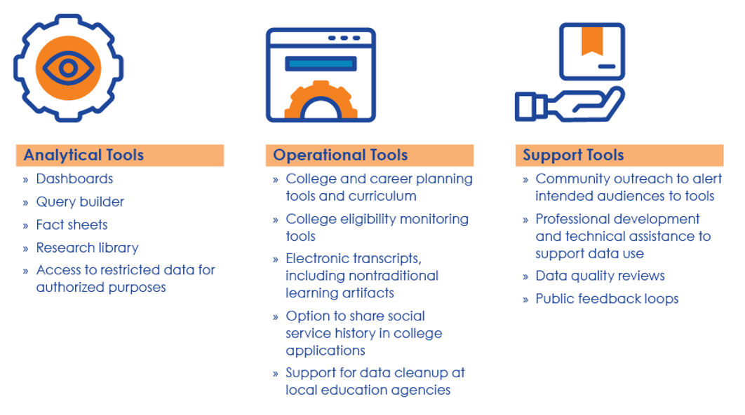
Cradle-to-Career data system tools

Slide 9
Examples of Tools for Students
Foster Youth: Students can authorize the Department of Social Services to alert the colleges they apply to about their status as foster youth, so the college can work with them from day one about financial aid and other supports that are available to them.
College Students: Students send an electronic transcript when they apply to college and include examples of badges or competency-based certifications.

Slide 10
Why This Matters for Employers
The impact of the pandemic and the disruptions to education will ripple throughout our economy, so understanding what happens as students move from one system to the next will help communities strengthen our recovery
Even before the pandemic, California wasn’t producing enough college graduates, so educators need more comprehensive information to help students plan for, apply to, and pay for college
The pathways from education to employment isn’t always a straight line, and we need to be able to better understand how education, social service, employment, and retraining intertwine, and how this varies by student population type

Slide 11
Examples of Tools for Families and Educators
College and career planning: Families will be able to access to information about education and career options. Parents can see whether their children are on track to meet a-g requirements and work with their schools to make course corrections.
Financial aid: High school counselors can view whether students are completing their financial aid applications and provide more support to ensure that students can afford higher education.
Better data: High schools can get help to ensure their courses are correctly flagged for a-g status, so there aren’t problems with students’ college applications.

Slide 12
Examples of Dashboard Content
All of these topics will be displayed as infographics that allow users to see trends over time and the outcomes for different groups of students, such as by race, gender, socioeconomic status, and many characteristics from disability to veteran status.
Results can be viewed at the local institution, regional, and statewide levels.
Which colleges do K-12 students apply to, get accepted to, enroll, and persist in?
How many students are eligible for financial aid but do not apply? How many students apply for financial aid but do not receive it?
When students in community colleges transfer to a four-year institution, do they successfully earn a bachelor’s degree?
How much do students earn after they graduate from college and what type of industries employ them?
Notes:
Kathy Booth

Slide 13
Examples of Query Builder Content
Users can select variables of their choice to generate tables and charts on student outcomes, with the ability to get more specific information about student experiences, such as:
How do community college transfer outcomes vary for students differ based on:
Educational goal
Transfer preparation level
Award type and program
History of enrollment in multiple colleges
Declared major
Notes:
Kathy Booth

Slide 14
Focused on privacy and neutrality
Data will be hosted by an independent third party—the Government Operations Agency—with oversight from a governing board that is accountable to taxpayers. It will not conduct its own research or issue policy statements.
For college eligibility, transcript, and social service history data, individuals and their families, or authorized school personnel, will access tools through a password-protected interface.
When looking at education and career outcomes, the public will only see trends and summaries for anonymized groups of students, with individual information kept private.
For research projects, individual identities will be hidden, and studies must be approved through a data request process.

Slide 15
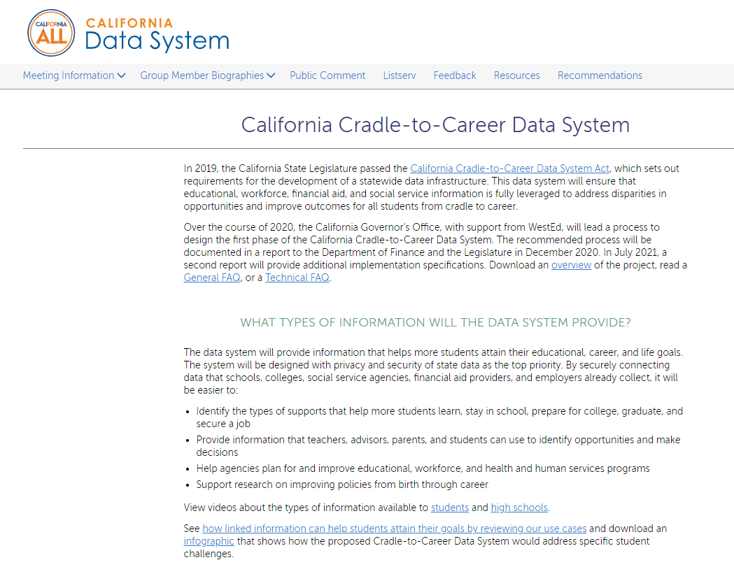
Read the specifics
Background information and recommendations are available at:
cadatasystem.wested.org

Slide 16
Resources
Website: https://cadatasystem.wested.org/
Join our listserv: https://cadatasystem.wested.org/listserv
All meetings are open to the public, have time allotted for public comment, and are held via Zoom
Questions? Email Kathy Booth kbooth@wested.org

